Slide 1




TAX
TOWN HALL
Understanding Tax Filing for 2023

Slide 2
1.
WHO HAS TO FILE
2.
SPRINTAX VS. SPRINTAX CALCULUS
3.
TAX REPORTING FOR FELLOWSHIPS / ASSISTANTSHIPS
4.
INDIVIDUAL TAXPAYER IDENTIFICATION NUMBER (ITIN)
5.
FILING SUPPORT
6.
FREQUENTLY ASKED QUESTIONS
7.
CONTACT INFORMATION
8.
QUESTIONS
WHAT WE WILL COVER

Slide 3
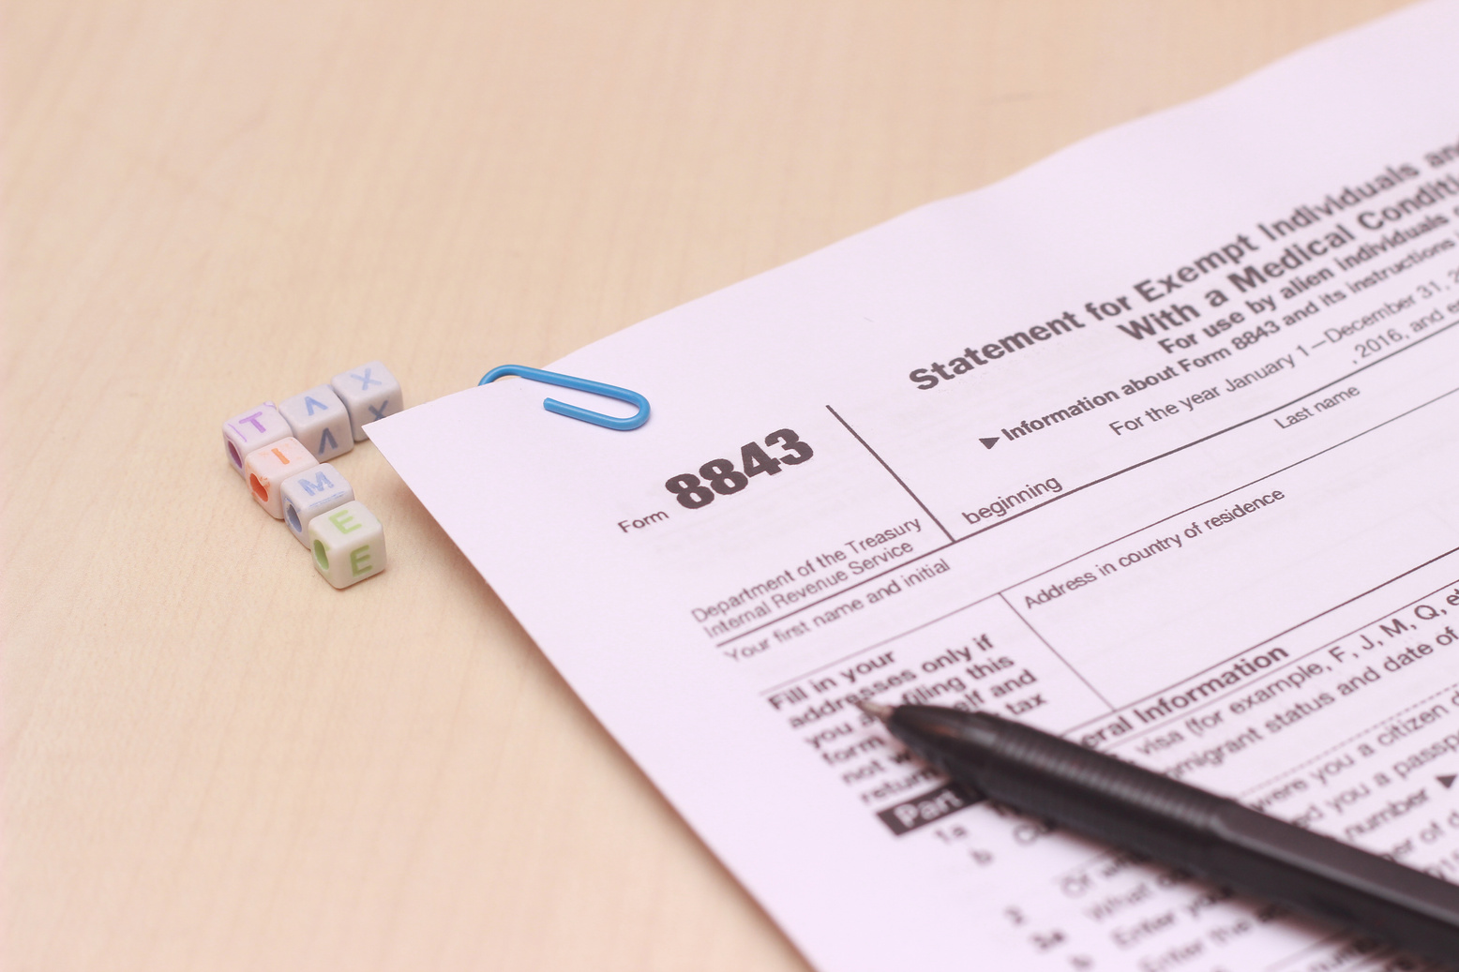
WHO HAS TO FILE?
Anyone who was in the US during the 2023 calendar year.
  Every international student, scholar and employee has a tax filing requirement.
  Even if you did not earn income, if you are a nonresident alien, you must file Form 8843.
  Consequences for failing to complete your tax return could include denial of visa renewal.

Slide 4
SPRINTAX
  Tax preparation software
  Used by nonresident aliens to file taxes for the 2023 calendar year
  Helps you determine if you will receive a refund or have to pay taxes
SPRINTAX CALCULUS
  Tax compliance software
  Determines tax residency status, tax treaty benefits eligibility and appropriate tax withholding rates
  Generates Form 1042-S, which you will need to file your tax return

Slide 5

SPRINTAX CALCULUS
Who needs a Sprintax Calculus profile and where to find the link?
  Generally, all foreign nationals who receive payments from the University should complete a Sprintax Calculus profile
  You will receive an email invitation from noreply@sprintax.com with the subject line “Welcome to Sprintax Forms System”
  Activate your account and complete your Sprintax Calculus Forms
  Information about Sprintax Calculus is on the Payroll Website

Slide 6
TAX REPORTING FOR FELLOWSHIPS / ASSISTANTSHIPS
Nonresident Aliens for Tax Purposes
  Withholding for Fellowships / Assistantships (position codes 6000 and 6002) depends on your eligibility for tax treaty benefits.
  You must complete your Sprintax Calculus profile and upload the necessary documents.
  To receive tax treaty benefits, you must have a Social Security Number (SSN) or Individual Taxpayer Identification Number (ITIN).
  Federal income tax will be withheld if Sprintax Calculus is not completed or there is no tax treaty benefit.

Slide 7
TAX REPORTING FOR FELLOWSHIPS / ASSISTANTSHIPS
Resident Aliens for Tax Purposes
  Fellowships / Assistantships (position codes 6000 and 6002) are not considered compensation for services (i.e. wages). These amounts are for your educational benefit (research or teaching requirements for your degree).
  They are not taxable if used for qualified expenditure:
    tuition and fees
    books
    supplies and equipment required for courses
  They are taxable if used for non-qualified expenditure, for example:
    room, board and other living expenses
    travel
    equipment not required as part of your education
  Fellowships / Assistantships are not subject to income tax withholding.
  You may be required to make estimated tax payments with the IRS and/or the NYS Dept of Tax (if you are a NY state resident).

Slide 8
TAX DOCUMENTS YOU MAY RECEIVE FROM THE UNIVERSITY OF ROCHESTER
W-2
WAGE AND TAX STATEMENT
1042-S
FOREIGN PERSON'S U.S. SOURCE INCOME SUBJECT TO WITHHOLDING
END OF YEAR LETTER
Issued to resident aliens who are in receipt of fellowships / assistantships.
This letter is for informational purposes only and is not required to be filed with the IRS or NYS Dept of Tax when you file your tax return.
Issued to employees of the University of Rochester, including students with on-campus employment or an add-on position (job codes 6004 and 6006).
Issued to nonresident aliens who are in receipt of fellowships / assistantships

Slide 9
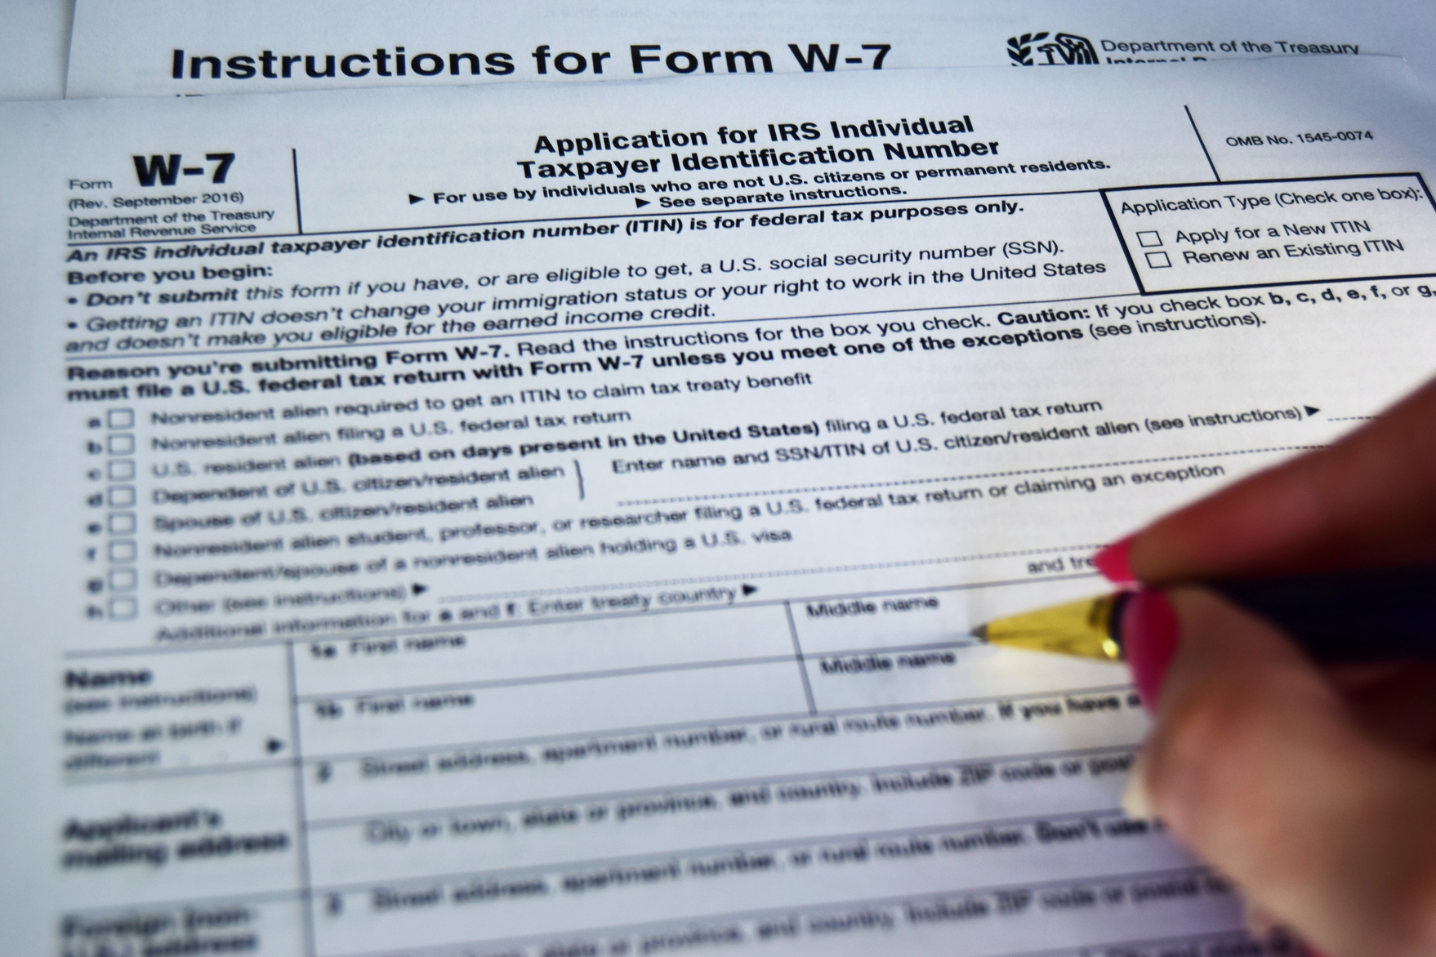
INDIVIDUAL TAXPAYER IDENTIFICATION NUMBER
If you are receiving non-service payments, and do not have a Social Security Number (SSN), you should apply for an ITIN.
  Make an appointment. Phone number: (844) 545-5640
  IRS Taxpayer Assistance Center: 255 East Avenue, Rochester, NY 14604
  Bring your documents:
    Completed W-7
    Original Passport & Student Visa
    Signed I-20 / DS-2019
    Original Tax Return for which the ITIN is needed
Non-Service Positions
  Academically required - not considered employment
  Coded: 6000, 6001, 6002, 6003, 6100, 6101, 6102, 6103
  Eligible for ITIN

Slide 10

Sprintax Tax Preparation & Filing
Access Sprintax via the dedicated University of Rochester link to ensure Sprintax covers your federal filing fee.
SUPPORT FOR NONRESIDENT ALIENS

Slide 11

SPRINTAX NONRESIDENT TAX WEBINARS
In these tax webinars, international students, scholars and professionals will be run through everything they need to know about nonresident tax for the 2023 tax season. Topics will include who must file, tax residency, FICA, state returns, implications of misfiling as well as how to use Sprintax to prepare a compliant tax return.
  Thursday, January 25th @ 12pm EST – Register here
  Wednesday, February 7th @ 1pm EST – Register here
  Wednesday, February 28th@ 12pm EST – Register here
  Monday, March 11th @ 4pm EST – Register here
  Thursday, March 28th @ 3pm EST – Register here
  Wednesday, April 3rd @ 2pm EST – Register here
  Thursday, April 11th @ 1pm EST – Register here
  Monday, April 15th @ 11am EST - Register here

Slide 12
SPRINTAX NONRESIDENT TAX OVERVIEW FOR OPT/CPT
Topics covered in these webinars will include residency for tax purposes, tax liabilities when on OPT/CPT and pre-employment tax forms when on OPT/CPT. The Sprintax team will also provide an overview of Sprintax Forms which can be used to prepare your pre OPT/CPT employment tax documents.
  Tuesday, January 23rd @ 1pm EST – Register here
  Wednesday, February 28th @ 2pm EST – Register here
  Thursday, March 21th @3pm EST – Register here

Slide 13
TAX CONSULTATIONS
Sangeeta Sarraf, CPA
  Starting January 30th, 2024, continuing through April 2024
  Available Tuesday and Friday, 2pm-4pm EST
  Consultations / answering questions via email and on Zoom (may be available in-person if requested)
  Contact through ISO (tax@iso.rochester.edu)
  Tax preparation / filing assistance not included

Slide 14
SUPPORT FOR RESIDENT ALIENS
PHUONG NGUYEN, CPA, MBA, CISA
WELKER MOJSEJ & DELVECCHIO
H&R BLOCK
  Experienced consultant
  Virtual advisory services
  Flexible outside of business hours
  Email: Phuong.Nguyen@proflexcpa.com
  921 Genesee St, Rochester, NY 14611
    585-436-0763
  1000 Hylan Dr, Rochester, NY 14623
    585-424-2320
  Certified Public Accountants, LLC
  1200 Jefferson Rd, Ste 300, Rochester, NY 14623
    585-292-1041
This information is provided as a courtesy. The University of Rochester does not vouch for or vet the above services; it is not responsible for their advice or any outcomes, and individuals are responsible for making arrangements and negotiating payments.

Slide 15
OTHER OPTIONS FOR TAX FILING
IRS Free File
Complete and File Your Own Tax Forms
Guided Tax Preparation (for Adjusted Gross Income $73,000 or less):
  Free federal return if you qualify
  Answer simple questions
  Guided preparation does all the math
  Tax filing done on an IRS partner site
  Some state tax preparation and filing are free
https://www.irs.gov/filing/free-file-do-your-federal-taxes-for-free
  Gather the forms and receipts that show the money you earned and the tax-deductible expenses you paid
  The instruction sheet that prints with your tax return or forms will provide you with specific information regarding which documents should be included with your tax return.

Slide 16

Nonresident aliens using Sprintax can file federal taxes for free. You must pay for state tax filing
You do not need a Social Security Number (SSN) or Individual Taxpayer Identification Number (ITIN) to file Form 8843
IMPORTANT TAX INFORMATION
You will need an SSN to E-file
Filing deadline is Monday, April 15

Slide 17
FREQUENTLY ASKED QUESTIONS
HOW CAN I FIND OUT MY TAX RESIDENCY STATUS?
  Your Sprintax Calculus Tax Summary will list your residency, as well as the timeframe when that category might change.
  Sprintax tax preparation software will calculate your residency to support your compliance with tax requirements.

Slide 18
FREQUENTLY ASKED QUESTIONS
IS FILING WITH SPRINTAX FREE?
Filing nonresident alien Federal taxes is free with use of the dedicated UR link. However, students must pay for individual State tax filing.

Slide 19
FREQUENTLY ASKED QUESTIONS
CAN I USE SPRINTAX IF I AM A RESIDENT ALIEN?
Sorry, the answer is no. There are other resources available for students who are considered residents for tax purposes. Fees apply.

Slide 20





Sprintax
hello@sprintax.com for 24/7 live chat help
Sprintax YouTube videos
ISO
tax@iso.rochester.edu for ISO questions
Payroll
FNPayroll@ur.rochester.edu for Payroll questions
TAX RESOURCES
IRS
irs.gov

Slide 21

SCAM AWARENESS
Click to watch

Slide 22
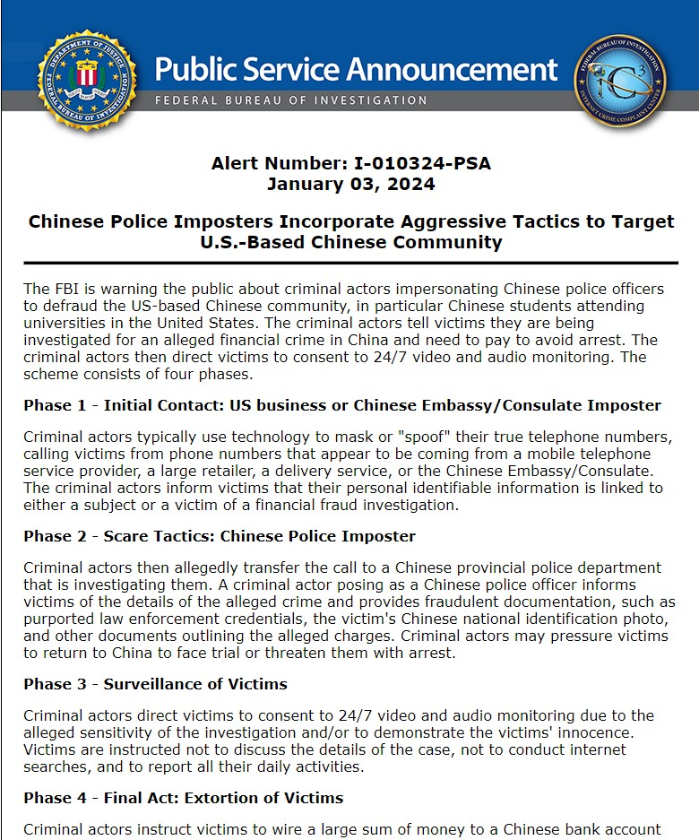
SCAM AWARENESS

Slide 23
THANK YOU
Questions?

